Slide 1
PHISHGUARD: A MULTI-LAYERED ENSEMBLE MODEL FOR OPTIMAL PHISHING WEBSITE DETECTION
Md Sultanul Islam Ovi​
movi@gmu.edu​
CS 700​
Fall 2023

Slide 2
Introduction
Escalating sophistication and frequency in cyber attacks
Financial and data losses from phishing incidents
Traditional methods inadequate against new phishing tactics
Multi-layered ensemble model for accurate, efficient detection

Slide 3
Techniques and System Analysis
Dataset
Phishing website dataset *
(11055 x 32)
Machine Learning Models
SVM
Random Forest
XGBoost
Data Preprocessing
Data Sampling
Feature Selection
Mean, Median, Quartiles - Box Plots
Performance Analysis
Hypothesis Testing
Confidence Intervals
ANOVA Test
Contrast Approach
https://www.kaggle.com/datasets/akashkr/phishing-website-dataset/data

Slide 4
Methodological Approach
Balanced dataset sampling followed by feature selection using Recursive Feature Elimination (RFE).
Utilized box plots to represent data distribution, outliers, and feature relationships.
Trained SVM, Random Forest, and XGBoost models using 10-fold cross-validation, focusing on accuracy and training/testing duration.
Utilized hyperparameter tuning (grid search) to optimize model performance, alongside metrics like precision, recall, and F1-score.
Conducted hypothesis testing and calculated confidence intervals.
Applied ANOVA and contrast approach to evaluate and compare model performances. (significance level = 5%)

Slide 5
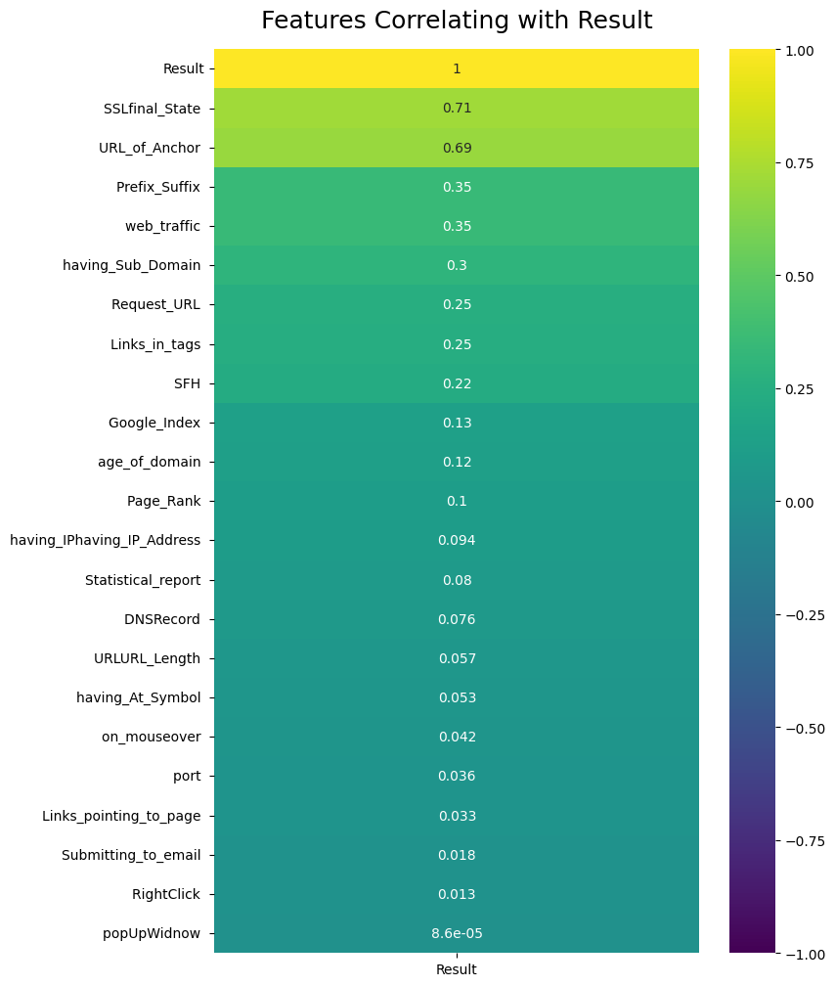
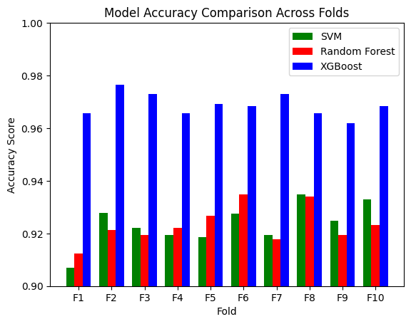
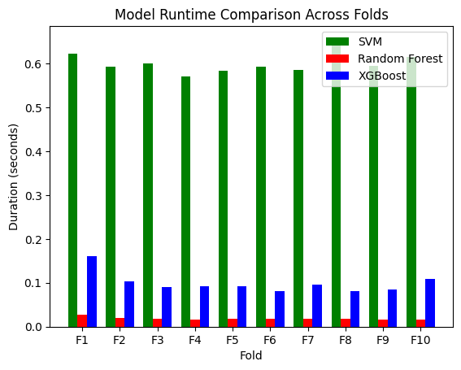
Preliminary Results
F-Statistic | 154.15584
P-Value | 1.7e-15
Decision | Significant differences
CI of SVM | (0.91769, 0.92927)
CI of Random Forest | (0.91808, 0.92814)
CI of XGBoost | (0.96560, 0.97180)
Comparison | Confidence Interval | Decision
SVM vs Random Forest | (-0.00441, 0.00514) | No significant difference
Random Forest vs XGBoost | (-0.05037, -0.04081) | XGBoost better
SVM vs XGBoost | (-0.05000, -0.04045) | XGBoost better
Table: Contrast Approach
Table: ANOVA Test

